Slide 1
Autonomous Urban Environment Navigation Using Reinforcement Learning
Nathan Durocher

Slide 2
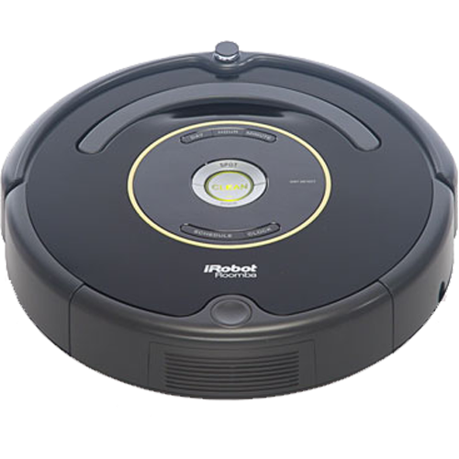
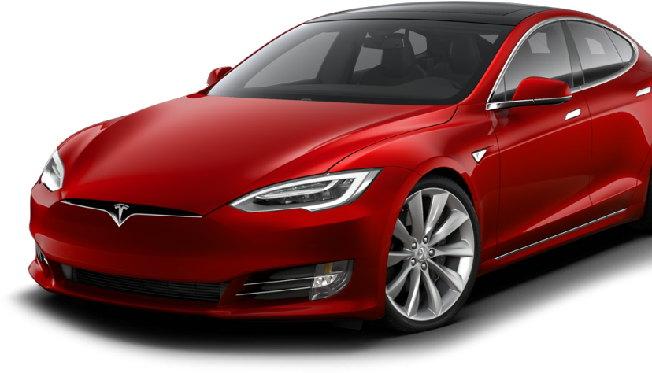
Why Urban Autonomous Navigation?
Notes:
Lets start with why Urban Autonomous Navigation,
Well if we think of some of the more well known autonomously navigating products we might think of a robot vacuum that slowly makes it way around your house or we might think of the more sophisticated driverless cars that can safely transport people from one location to the next. But if we think of the environments these system are typically in ->

Slide 3
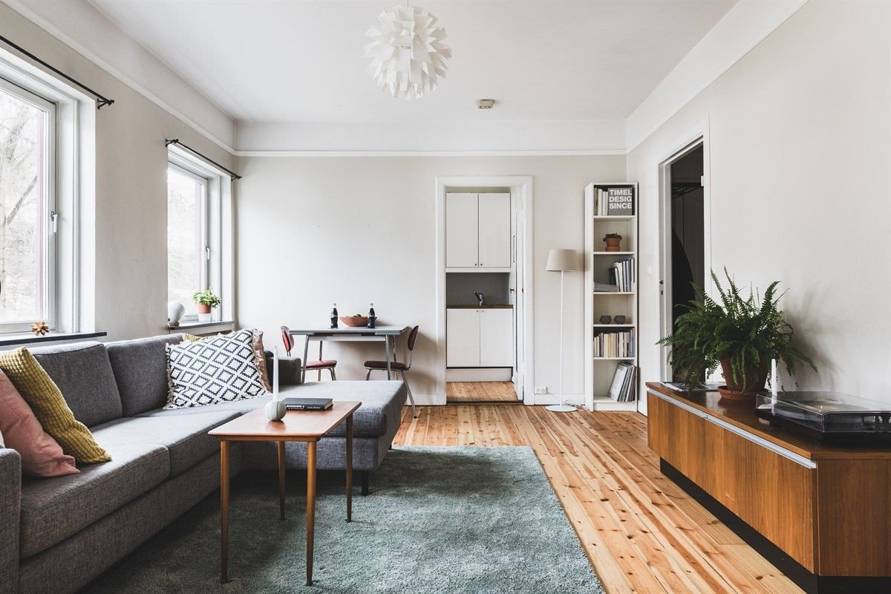
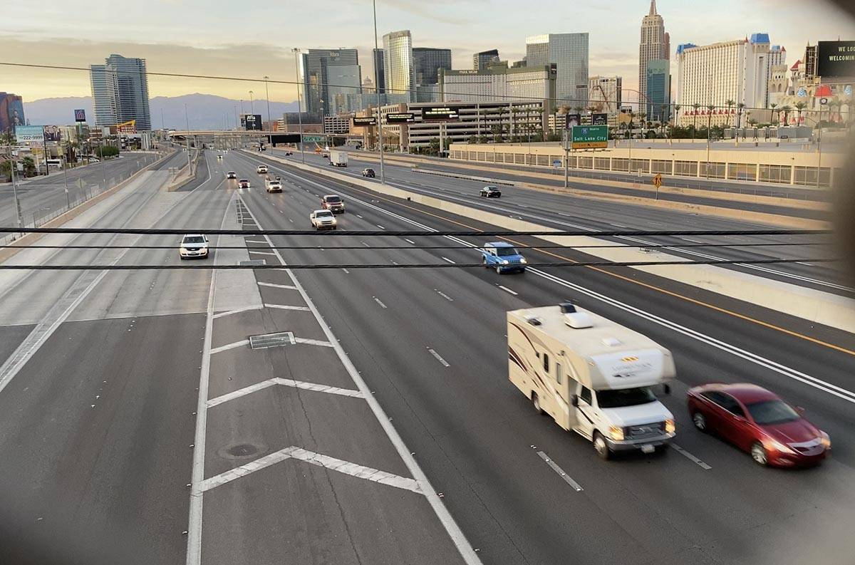
More predictable behaviour
Structured
Static Obstacles
Physically Bounded
Notes:
Like an apartment or a house for the Vacuum or a highway for the car, we can see these systems take advantage of some limitations in the environment with the vacuum operating most often without people home and being inside it is physically bounded and cannot run away, while the car is also in a structured highway with lanes are direction of travel – lending to more predictable behaviour from the dynamic obstacles. ->

Slide 4
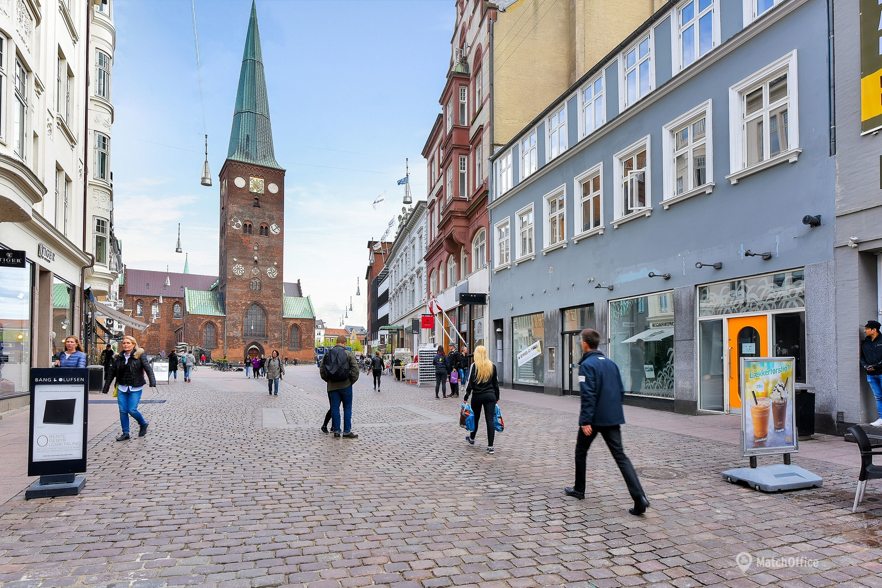
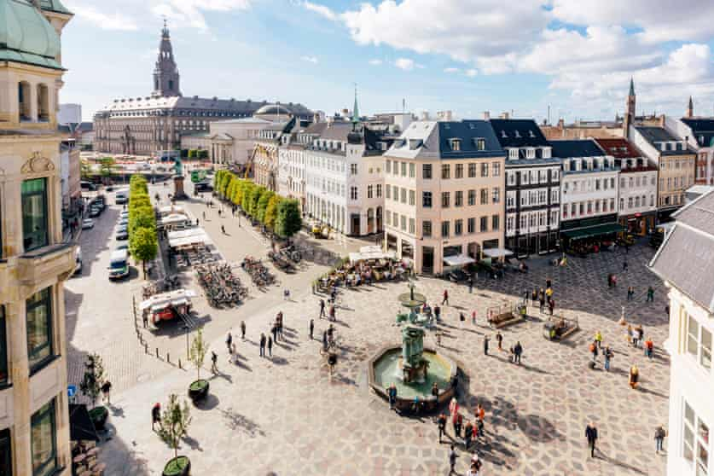
Notes:
But what if we wanted to have an autonomous system in a place like Aarhus’ Stor Torv, or somewhere in Copenhagen’s Indre By (Inner City)
These environments have some structure with building and roads providing some physical boundaries, however these environments are built for humans with little structure in mind and we as humans don’t always follow the structure.

Slide 5
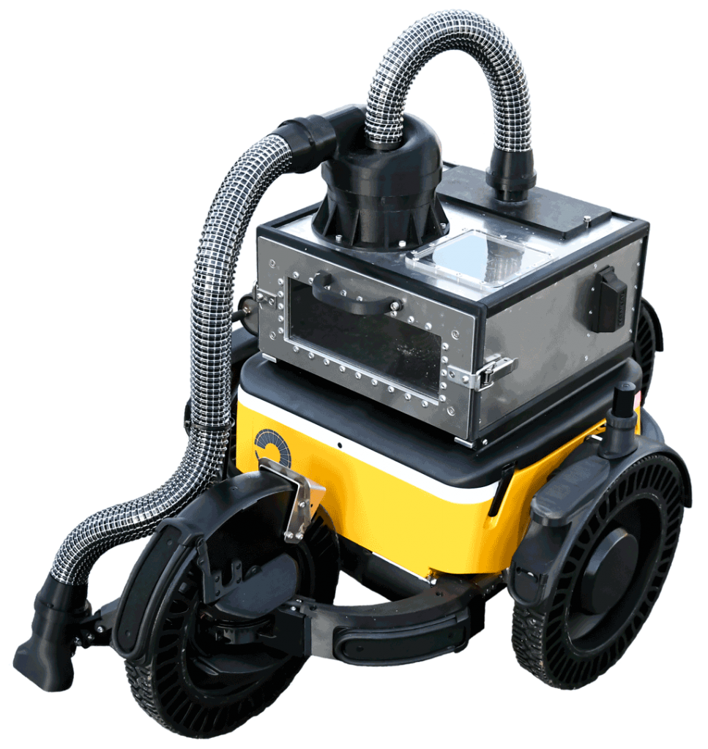
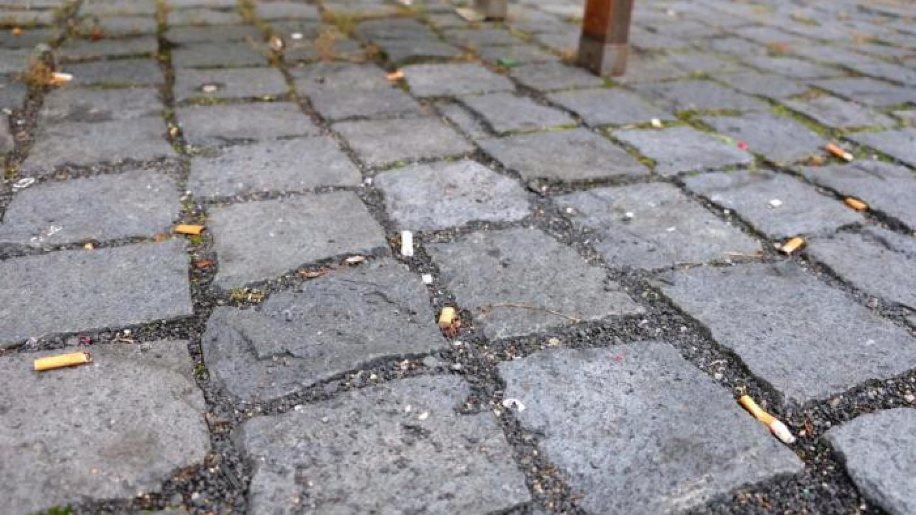
Notes:
So how should a robot like Capra’s Hircus, navigate and behave in these environments?

Slide 6
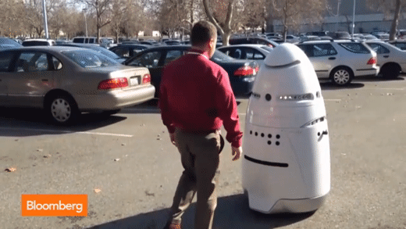
Goal

Slide 7
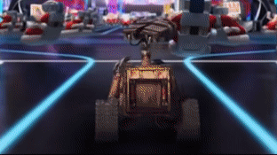
Goal

Slide 8
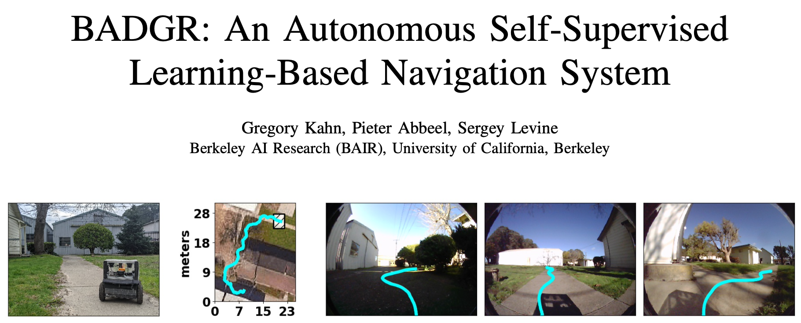
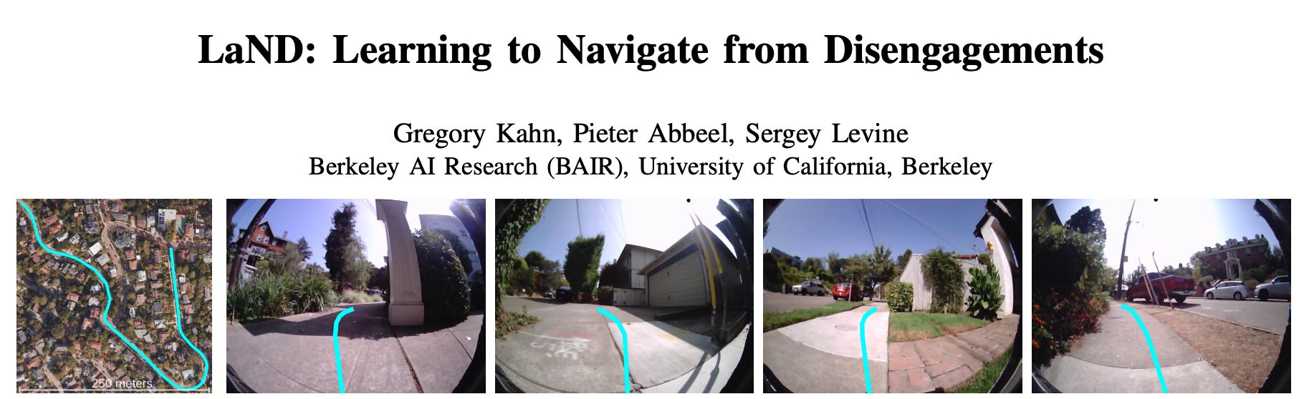
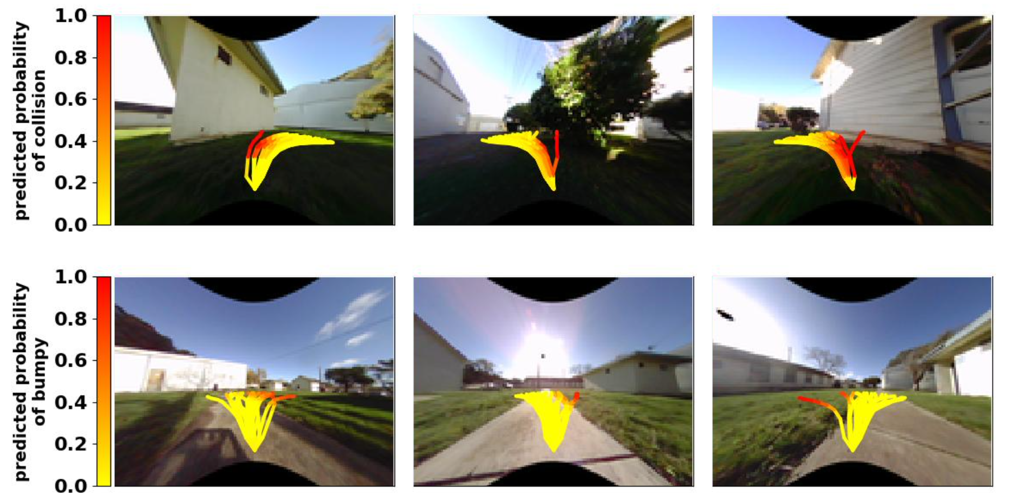
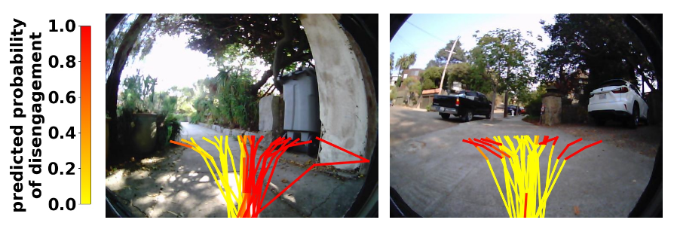
BADGR: An Autonomous Self-Supervised Learning-Based Navigation System, Gregory Kahn, Pieter Abbeel, Sergey Levine, https://arxiv.org/abs/2002.05700
LaND: Learning to Navigate from Disengagements, Gregory Kahn, Pieter Abbeel, Sergey Levine, https://arxiv.org/abs/2010.04689

Slide 9
Goal
Navigate successfully from one location to another, while avoiding collisions, roads and pedestrians
Create a learned approach – autonomously evaluate the environment
Optimizing pedestrian avoidance, with personal space definition
Methods
Vision-based deep learning control system
Uses statistical action planner
Distance to goal, Energy cost and estimated event to inform optimal actions

Slide 10
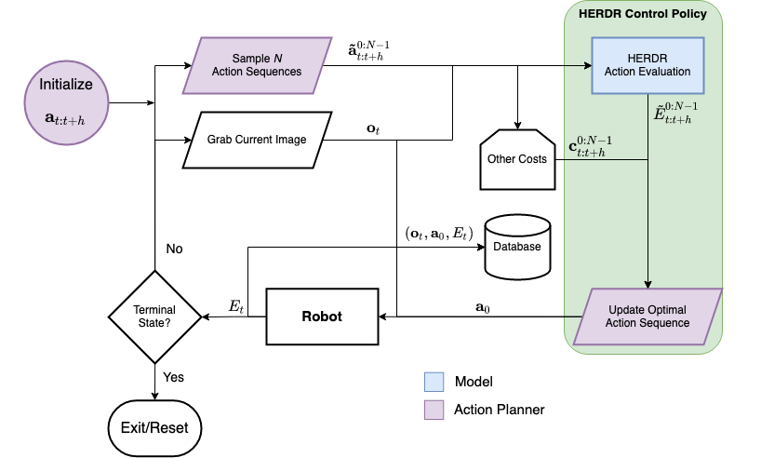
HERDR

Slide 11
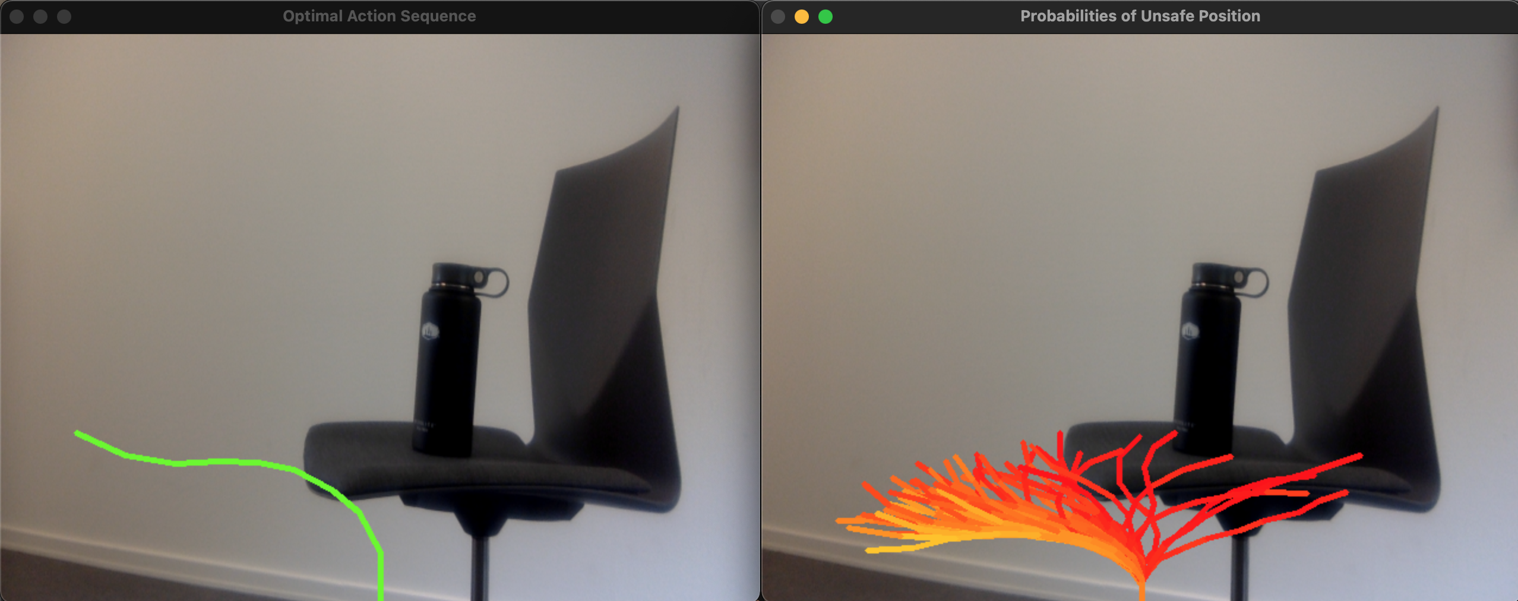
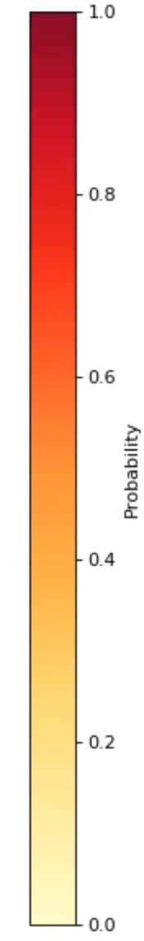
Action Planner

Slide 12
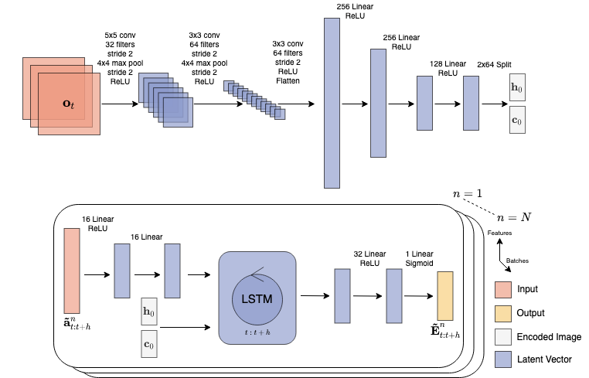
Model

Slide 13
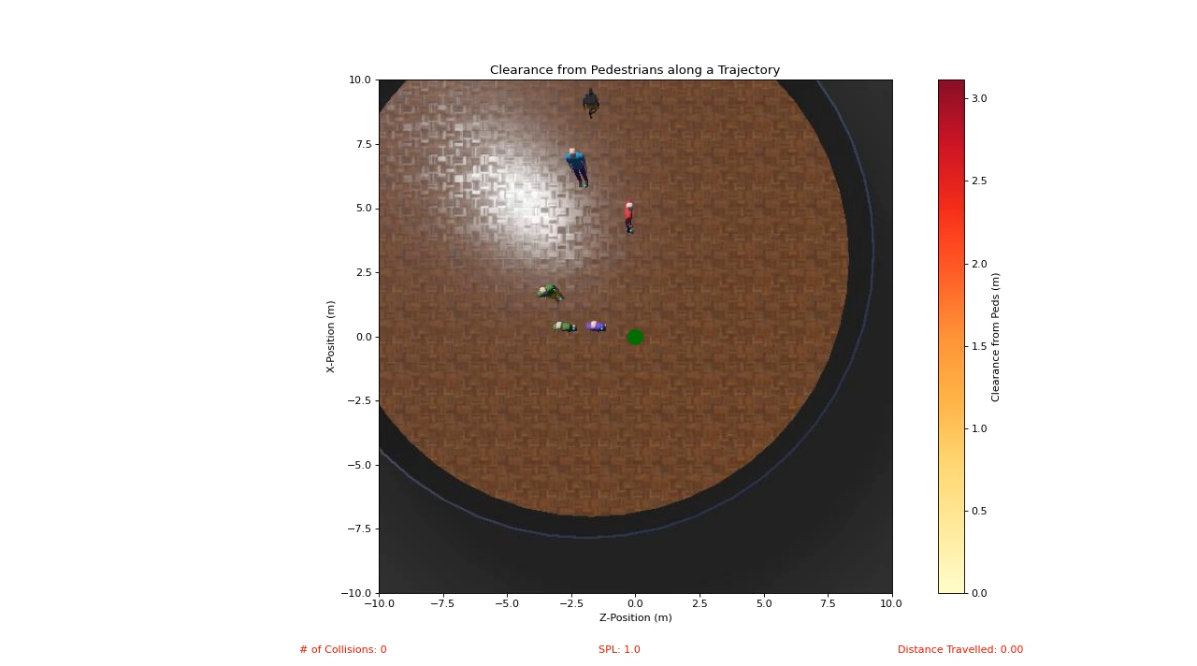

Slide 14
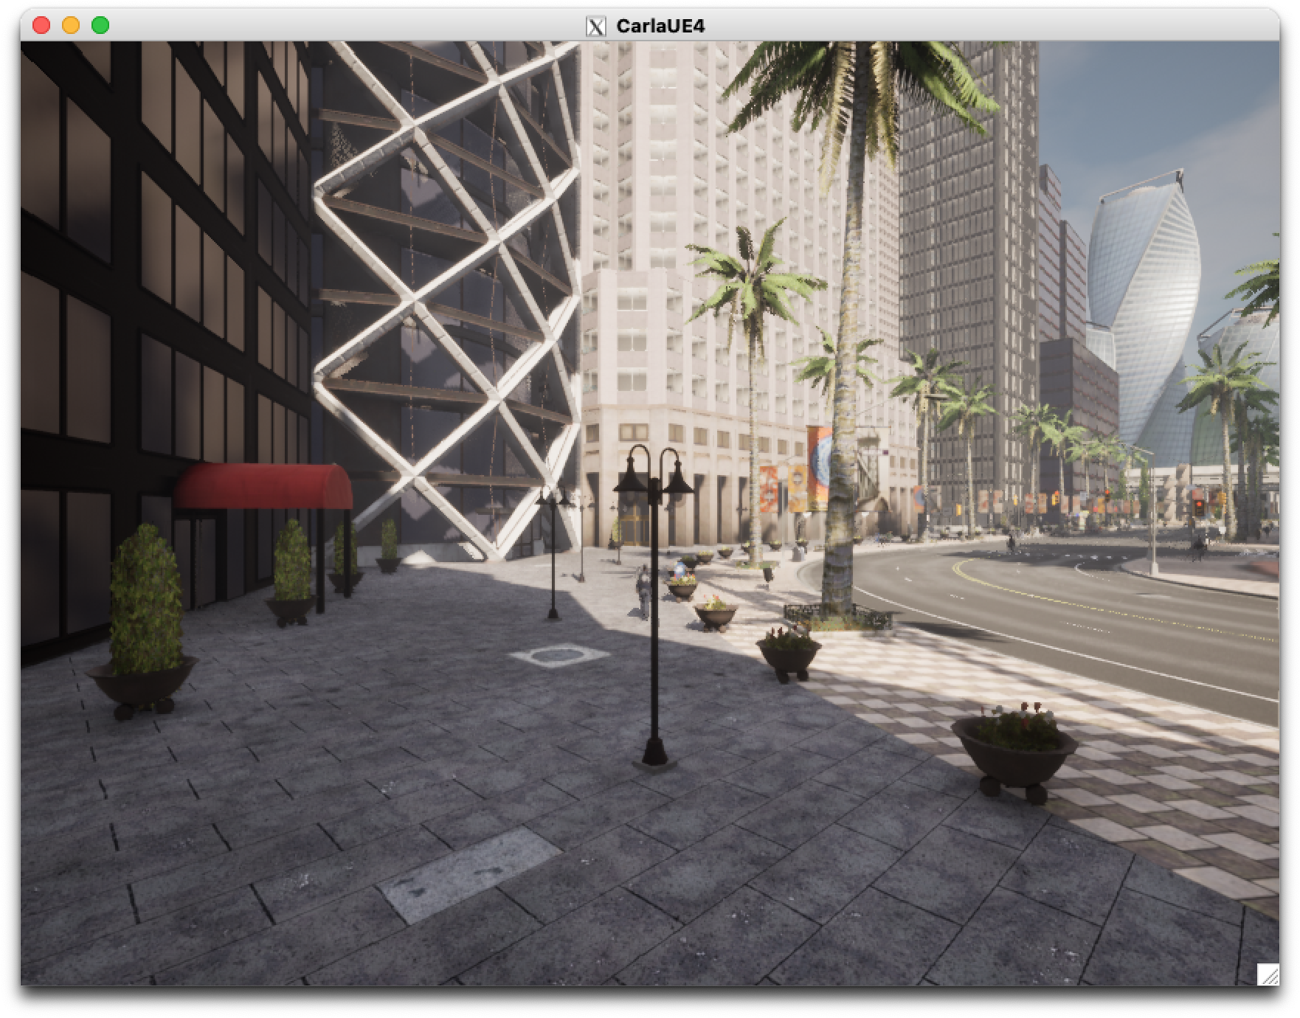
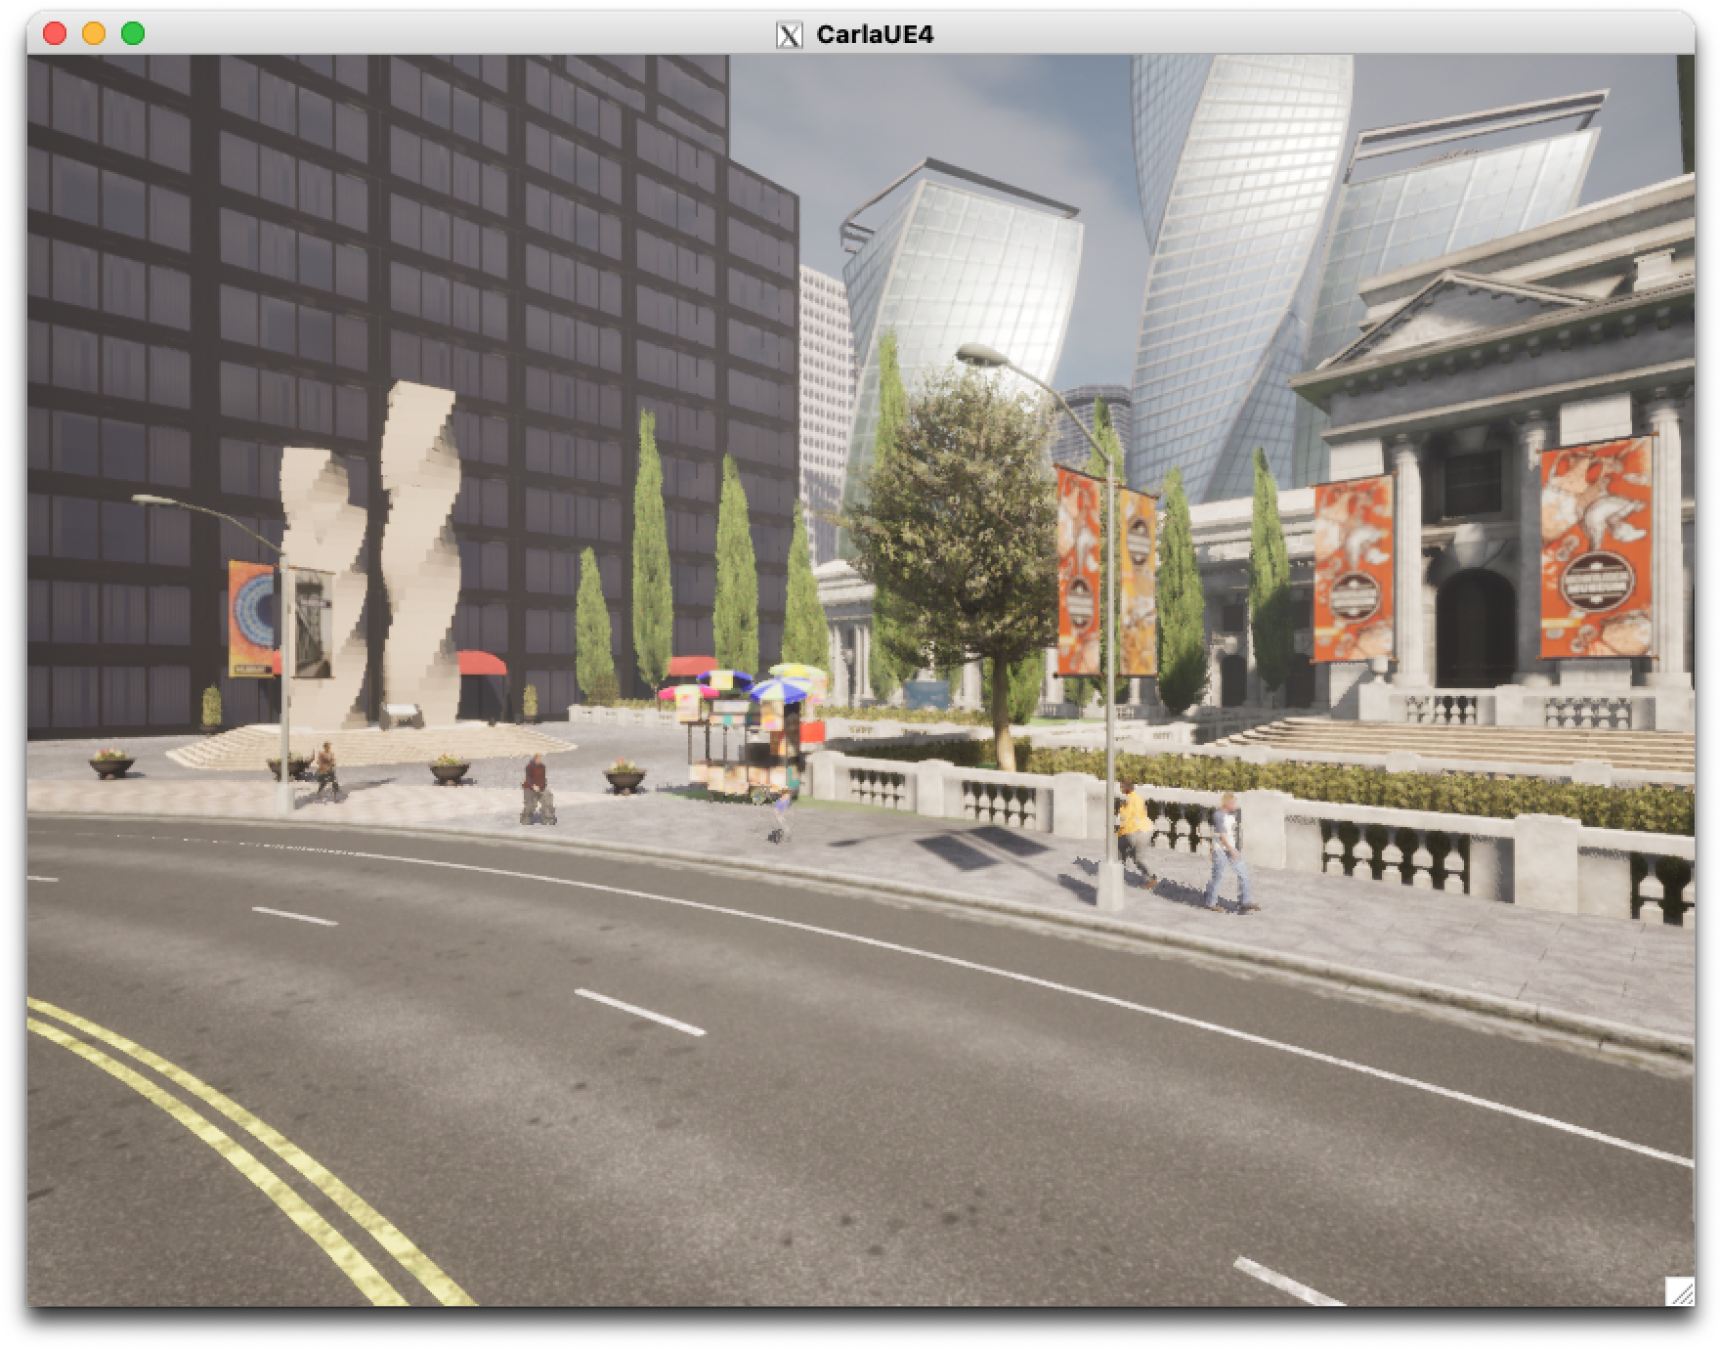

Slide 15
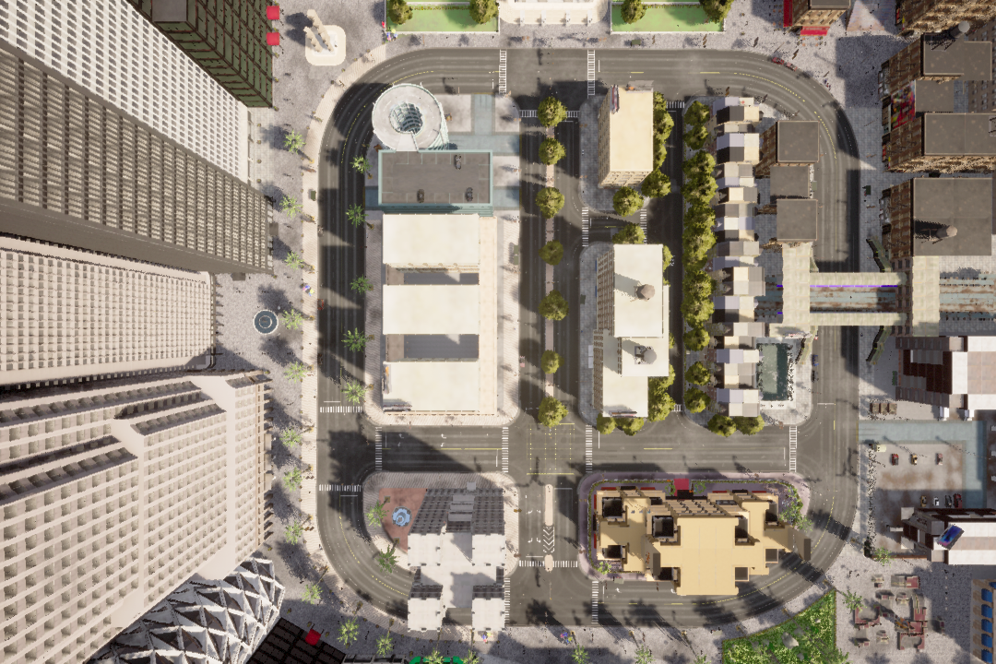

Slide 16
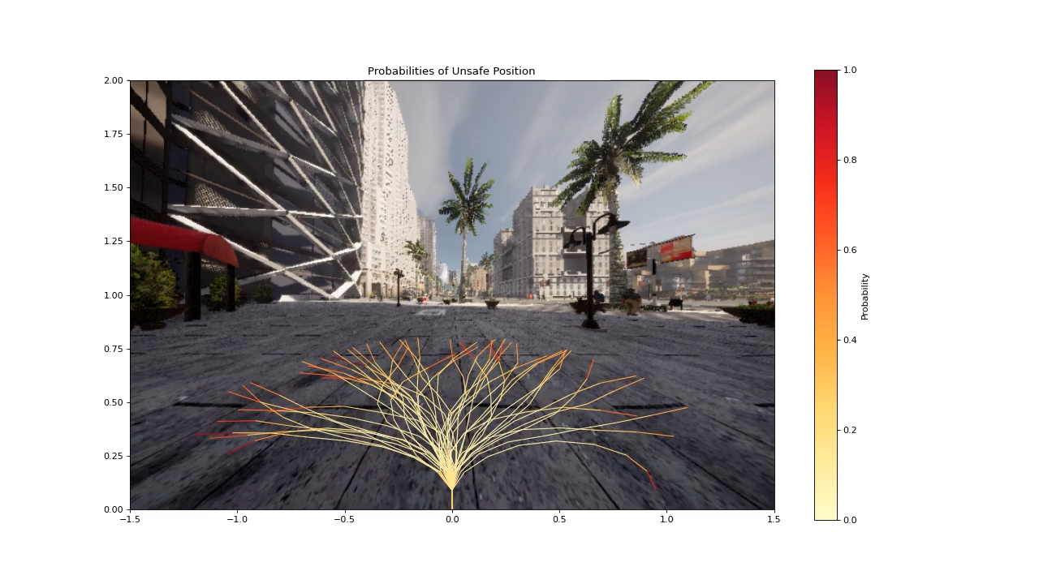

Slide 17
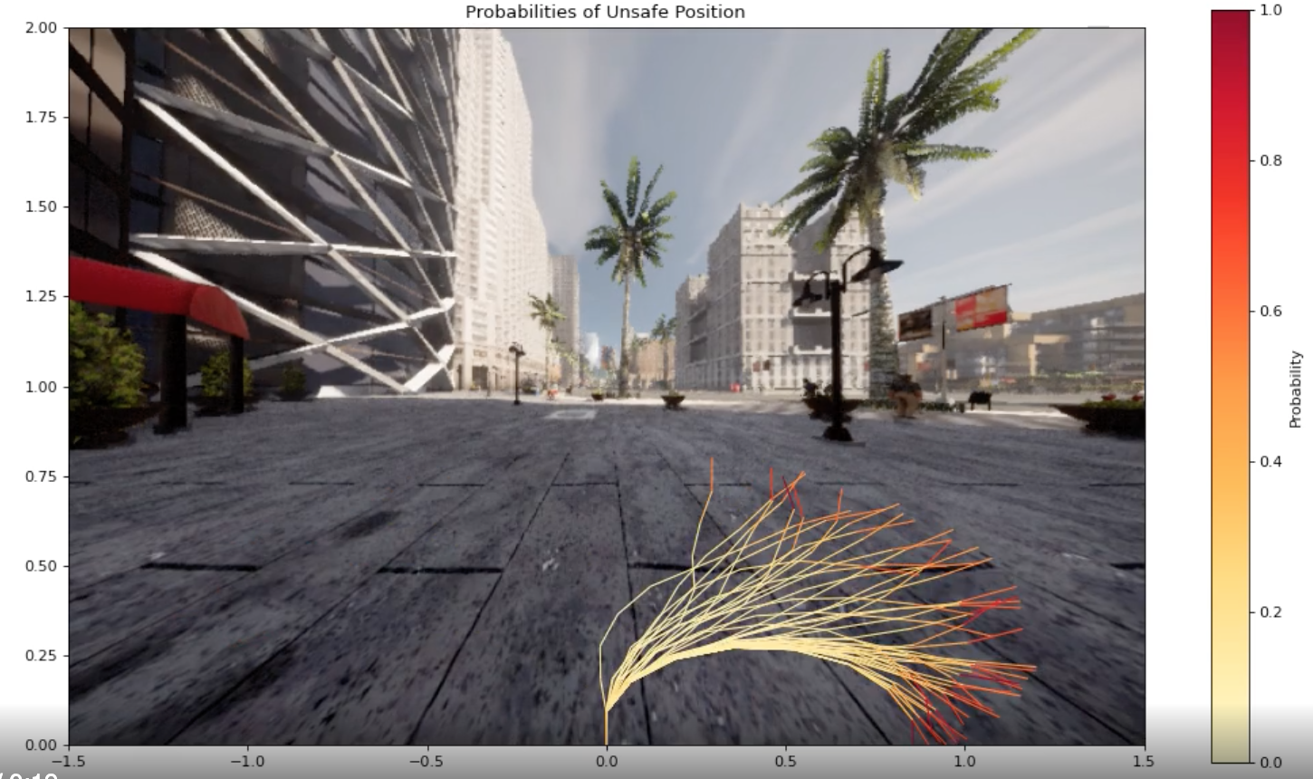
Added with CARLA
Roads/intersection
Smarter pedestrians
Static obstacles
Significantly more textured environment

Slide 18
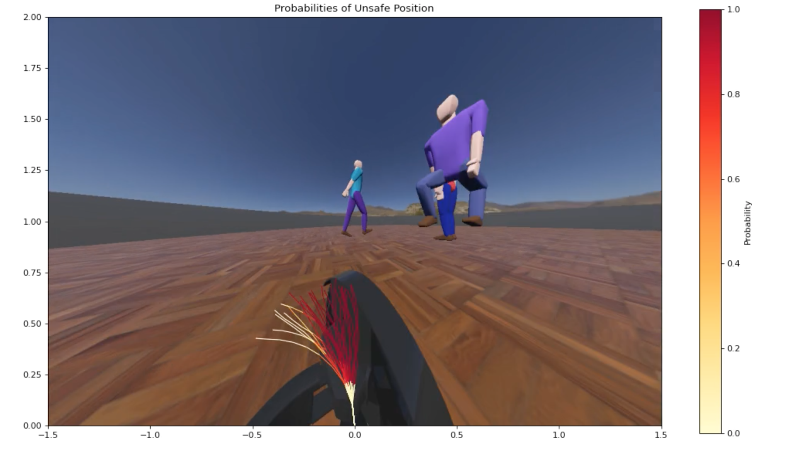
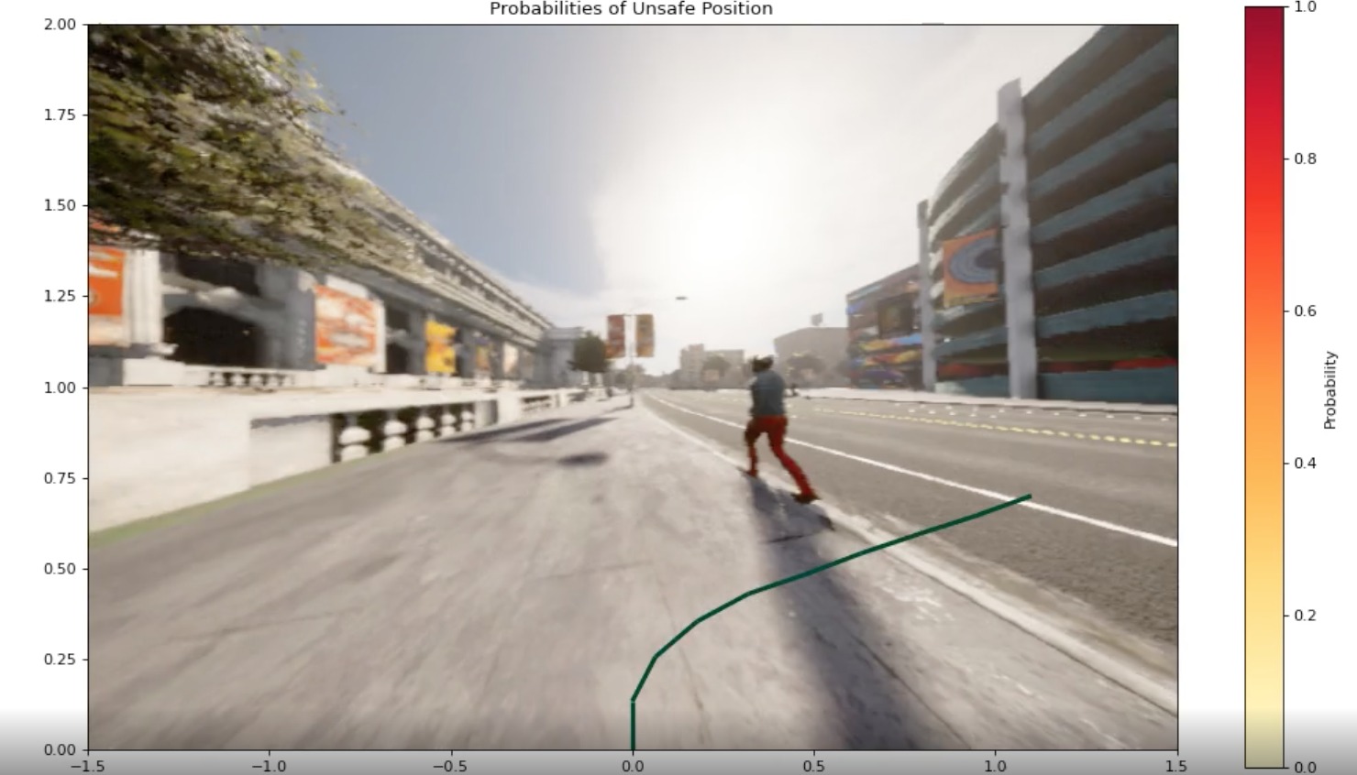
Difference in approach
Before
Now
N trajectories per image
1 trajectory per image

Slide 19
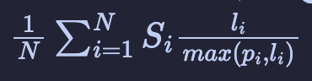
Metrics
# timesteps in pedestrian space
Distance traveled/ travel time
SPL – Success Path Length
Gives a metric to compare optimality of path while considering success rate, where success rate is a binary definition
To add
Distance to closest pedestrian(s)
Comparison to pedestrian path
Inference into what the model learned

Slide 20
Current objective
Record data with longer trajectories
Increase left/right disparity
Write my thesis 🙃

